Slide 1
How does indexes influence the databases?
Yuyang Liu | Zilong Tan | Peicheng Wen

Slide 2
Index Types
B-Tree
Bitmap
Hash?

Slide 3
Benefit of index
Accelerate the Transaction with a ‘WHERE’ clause
ORDER BY / GROUP BY
Enforce uniqueness in data of a column.
Drawback of index
Additional disk space
Slow down the modification

Slide 4
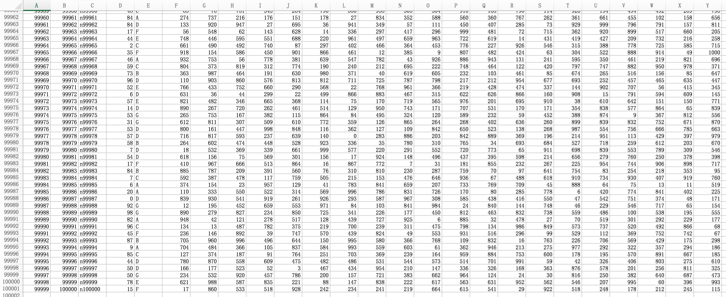
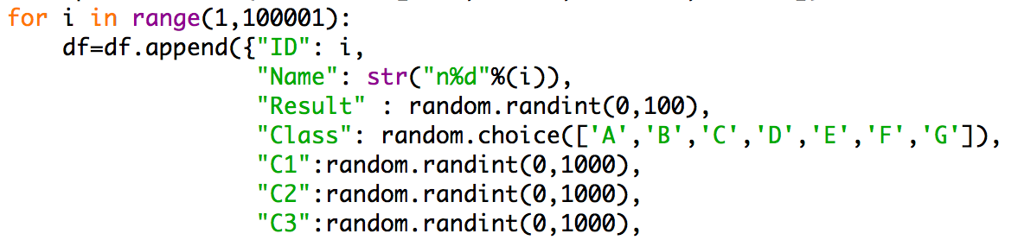
Accelerate the transaction ‘SELECT’ with ‘WHERE’
100,000 Rows 24 Columns

Slide 5
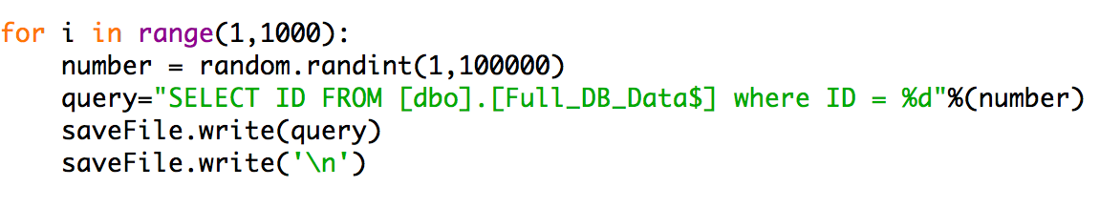
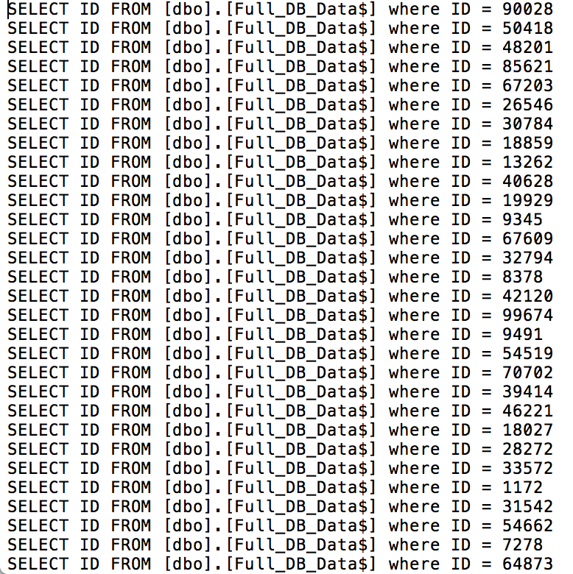
1000 Transactions

Slide 6
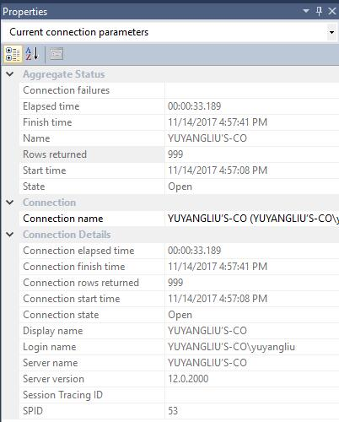
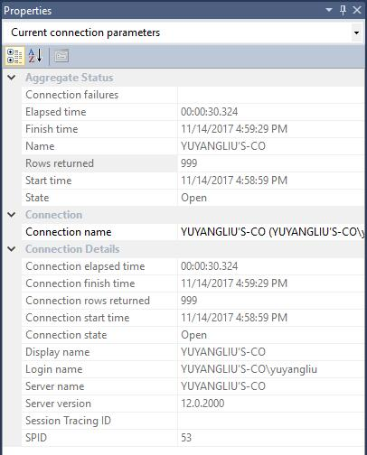
SELECT without indexes
SELECT with an index

Slide 7
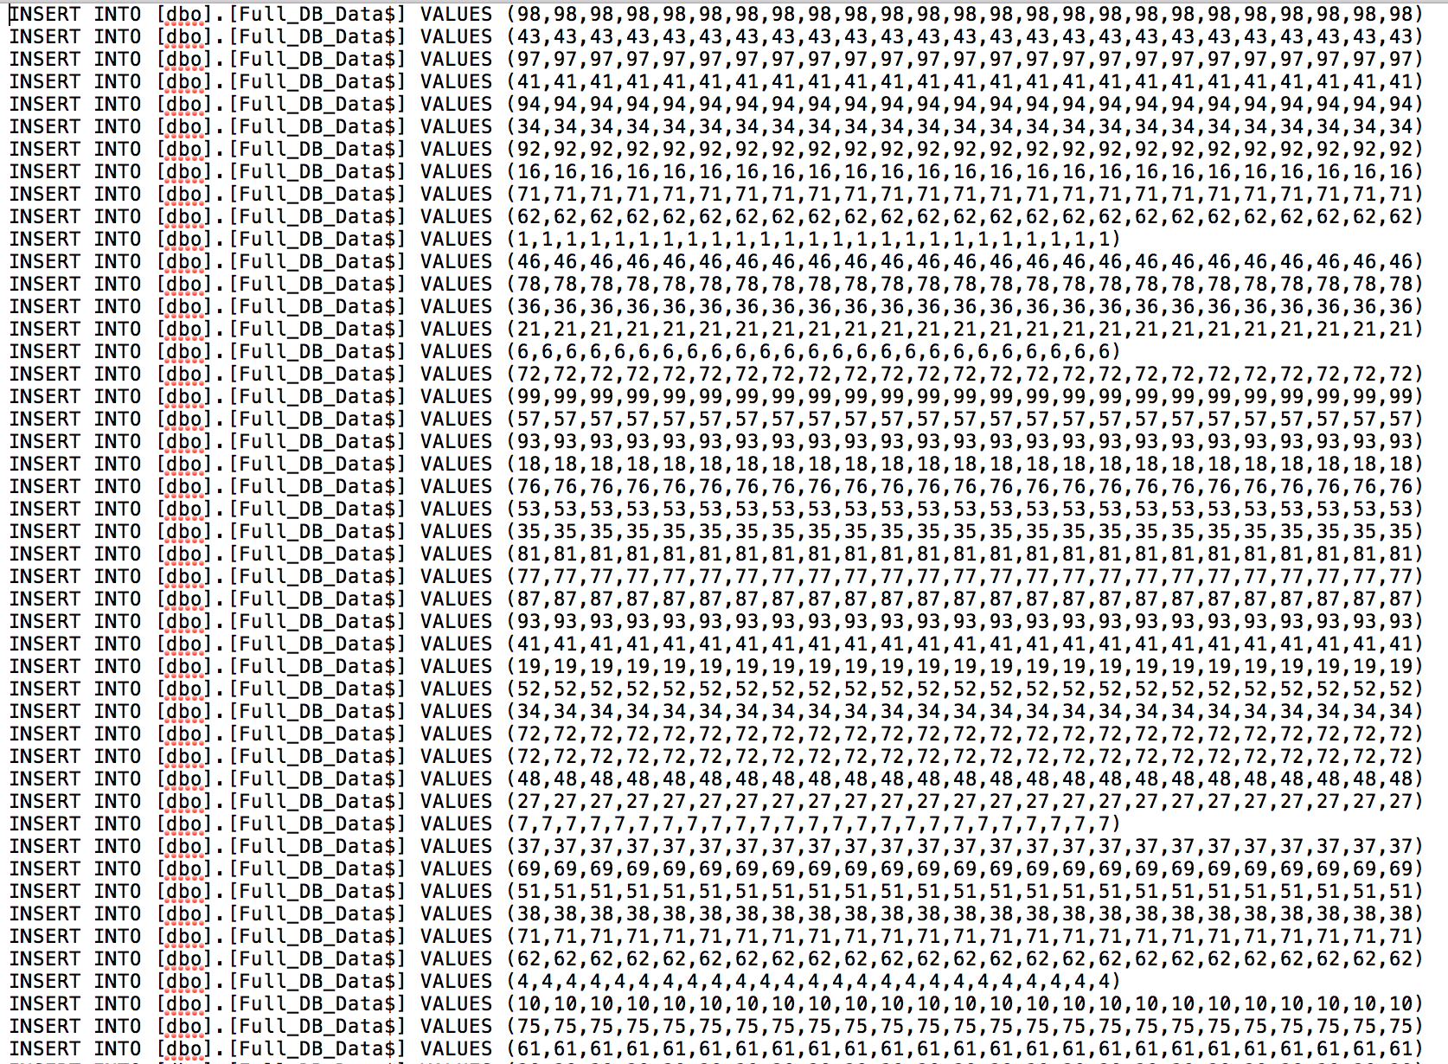
Slow down the transaction ‘INSERT’
1000 INSERT transactions

Slide 8
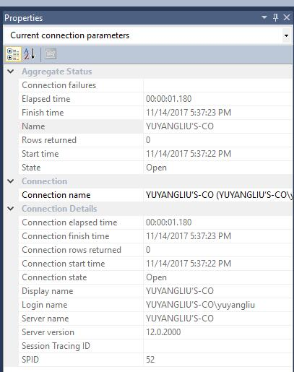
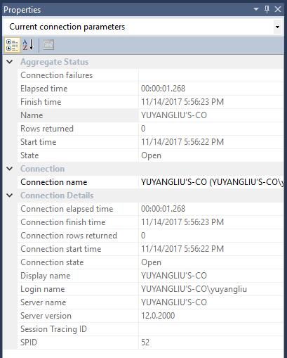
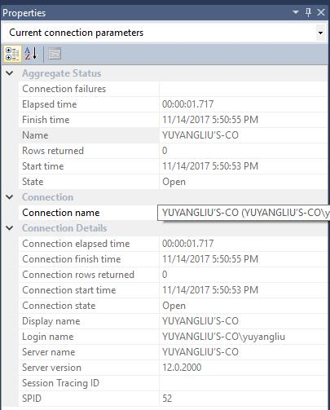
Insert without indexes
Insert with 5 indexes
Insert with 25 indexes

